Slide 1
For loops
Intro to CS

Slide 2

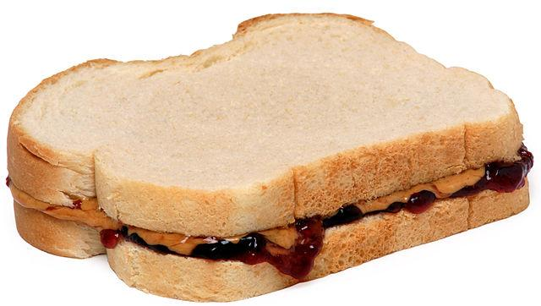
Aim: What is a for loop, and how can we use it in computer programming?
Do Now:
Mecha Mr. Zeng makes peanut butter & jelly sandwiches for Mr. Zeng during his free periods. Mr. Zeng wants to improve the mecha’s peanut butter spreading efficiency, but first he needs to measure how long it takes for the mecha to spread the peanut butter. In pseudo-code, write a while loop that will help keep track of the number of times mecha Mr. Zeng spreads peanut butter with it’s knife, until the side of a piece of bread is fully covered in peanut butter.

Slide 3
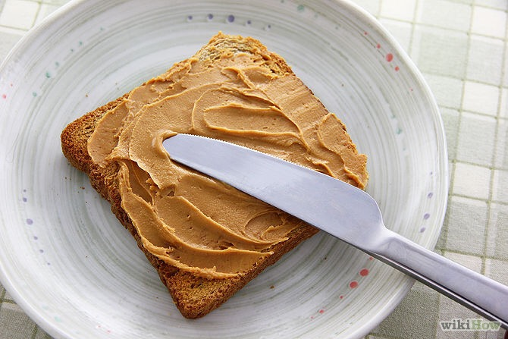
int numberOfSpreads = 0;
while (bread != fully spread) {
spread peanut butter with knife;
numberOfSpreads += 1;
}
We use a while loop to make sure mecha Mr. Zeng finishes the job of spreading the peanut butter. By creating an iterator “numberOfSpreads”, we can count every single time mecha Mr. Zeng performs the action “spread peanut butter with knife”. Now Mr. Zeng can work on improving mecha Mr. Zeng!

Slide 4
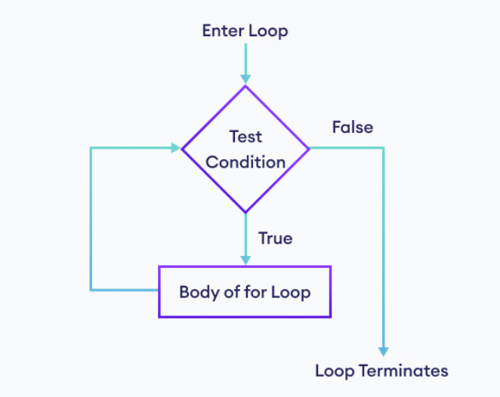
For Loops
For loops are a loop, just like while loops.
Any loop that you write using a while loop can be written using a for loop, and vice versa. Functionally, they are the same: execute code as long as a condition is true.
You can view for loops as a more concise way to write while loops with iterators. The three components of a for loop are the initializer of an iterator, the condition and the increment/decrement of the iterator.

Slide 5
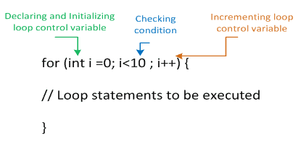
For Loops - cont.
Note: in this case, the loop control variable, “i”, stays INSIDE the loop!
As you can see, for loops are “cleaner” as put all the function of iteration in a single line of code.
For loops are very, very commonly used to traverse through arrays in computer programming, but you’ll learn more about what an array is later.

Slide 6
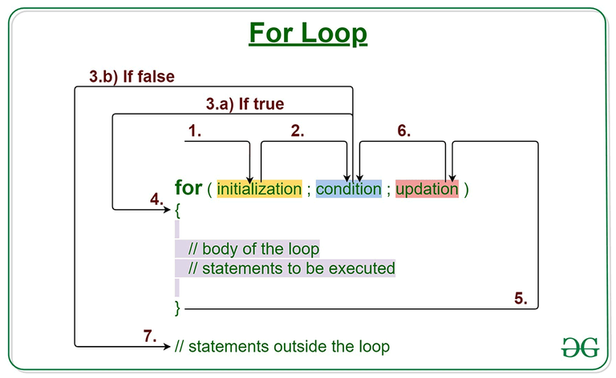

Slide 7
Let’s look at the for loop version of a while loop from last class…
int i = 1;
while (i <= 5) {
System.out.println(i);
i++;
}
This program prints out: 1 2 3 4 5
For loop template: for (the initializer; the condition ; the update)
We know this program runs a line of code exactly 5 times, and we also already know what it’s going to output. A lot of the work is already done since we have the while loop, which even had an iterator!
Take a minute to write out the for loop version of this program.
drag me!
Answer:
for (int i = 1; i <=5; i++){ System.out.println(i); }

Slide 8
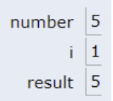
Trace Diagrams
int number = 5;
for (int i = 1; i <= 10; i++) {
int result = number * i;
System.out.println(number + " x " + i + " = " + result);
}
Trace through this program on a piece of paper. Make sure to keep track of where the computer is during each step of the program, as well as keep track of what the value of i and result are during each step.
Similar to this!

Slide 9
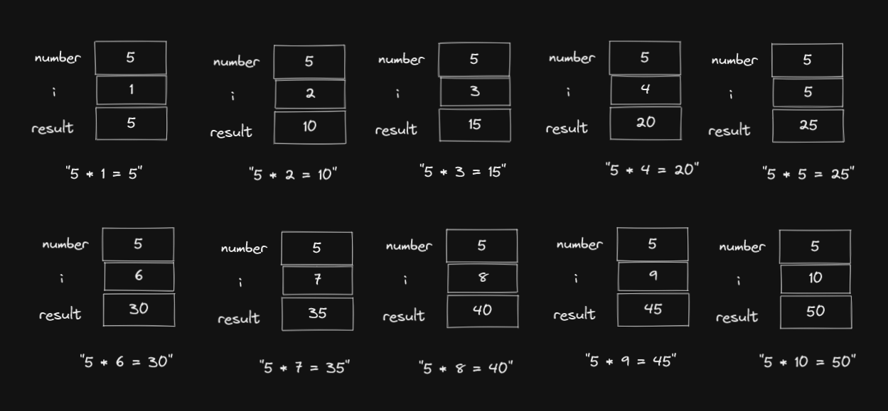

Slide 10
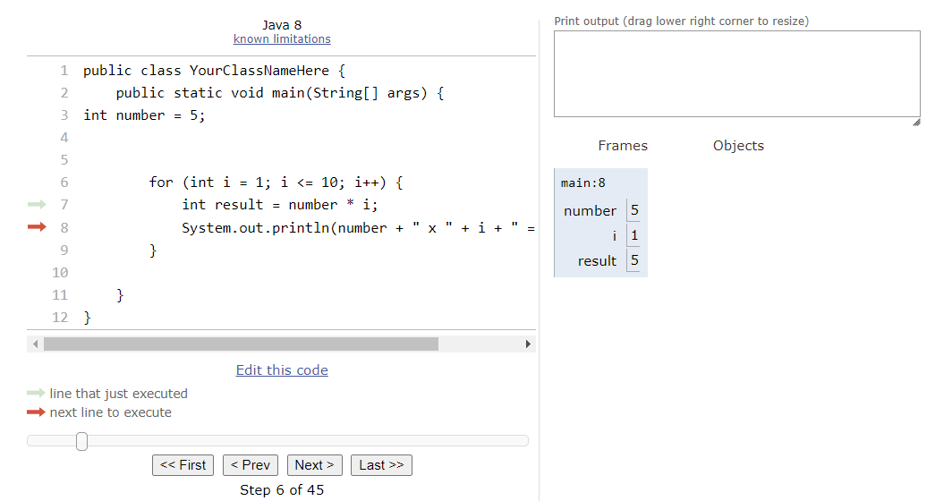
A cool resource that shows a visualization of code online!
https://pythontutor.com/java.html#mode=edit

Slide 11
Pair Programming
Work with the person sitting next to you! One person will be the navigator and the other will be the driver. When you finish writing the code for the first part, switch! You can comment out question 1 and then uncomment the starter code for question 2.

